Slide 1
Git & GitHub
Shiva Gaur

Slide 2
What is Git?
Git is a Version Control System
Tracks file changes over time
Helps teams work together
Restores previous versions easily

Slide 3
Why Use Git?
Keeps complete change history
Supports teamwork
Easy error recovery
Secure project management

Slide 4
Key Features of Git
Distributed system
Offline support
Branching for experiments
Fast merging

Slide 5
How Git Works
Working Directory – edit files
Staging Area – select changes
Repository – saved versions
➡ Flow: Edit → Add → Commit

Slide 6
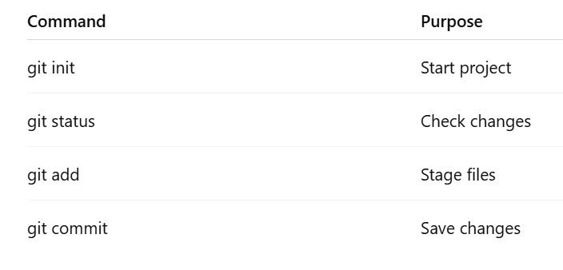
Basic Git Commands

Slide 7
Branches in Git
Branch = separate development line
Keeps main code safe
Used for new features
Commands:
git branch
git checkout
git merge

Slide 8
What is GitHub?
Online platform for Git projects
Code sharing & collaboration
Pull requests
Issue tracking

Slide 9
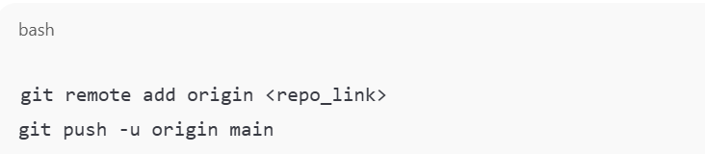
Connecting Git to GitHub
Steps:
Create GitHub account
Create repository
Connect local project

Slide 10
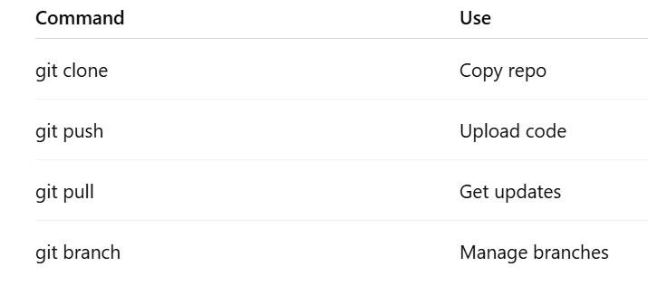
Important Git Commands

Slide 11
Why Git & GitHub Are Useful
Team collaboration
Version history
Safe experimentation
Online backup

Slide 12


